Slide 1
Transgender-Led Social Media Interventions Effectively Identify Transgender Women at Substantial Risk of HIV Acquisition and Successfully Link to HIV Prevention, Care, and Treatment Services
Rena Janamnuaysook
PREVENTION | Thai Red Cross AIDS Research Centre
USAID LINKAGES Program, Thailand
July 24, 2019

Slide 2
Disclosure
No conflicts of interest

Slide 3
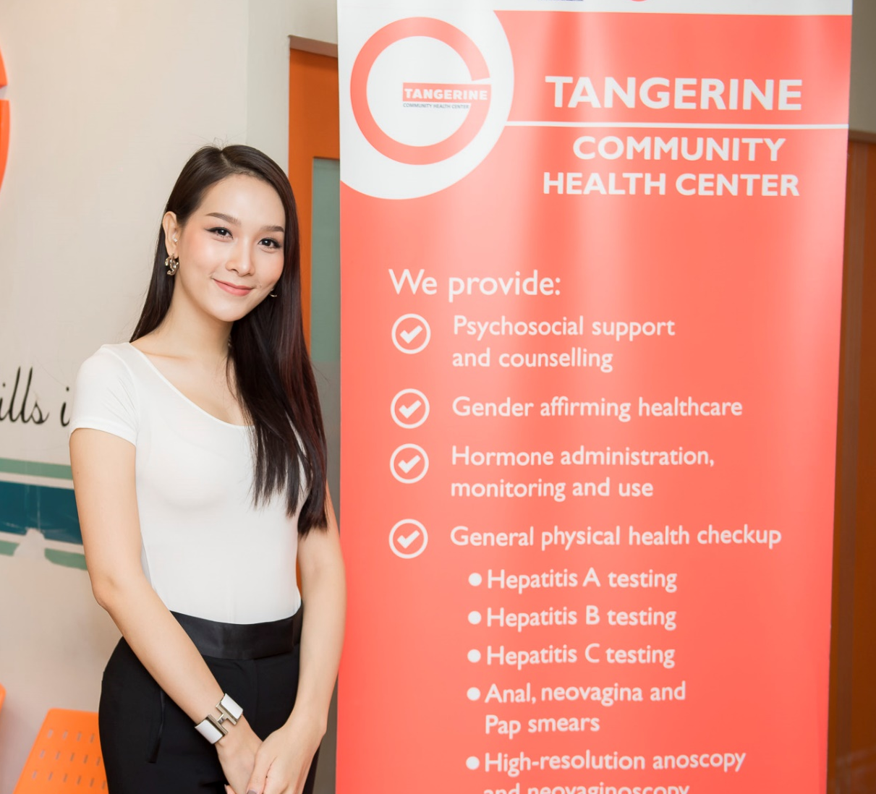
Background
Stigma, discrimination, and unavailability of trans-specific and trans-friendly services limit trans uptake of HIV services
In choosing a service provider, transgender people seek health information online and rely on experiences from trans social influencers.
The Tangerine Clinic uses trans-led, targeted social media interventions to facilitate uptake of HIV services through integrated, gender-affirming hormone treatment services for transgender women (TGW) in Bangkok, Thailand

Slide 4
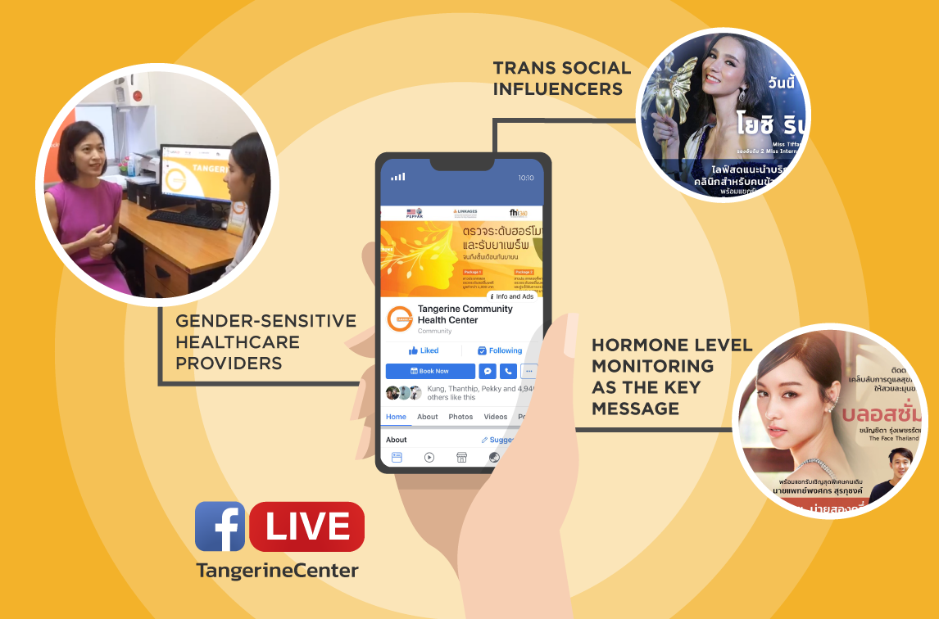
Method
Beginning in August 2017, trans social media influencers conducted Tangerine Facebook Live Sessions as the primary online demand-generation platform to link online networking to offline health service delivery.
Characteristics of TGW who were reached through social media and who subsequently accessed HIV and health services at Tangerine Clinic were recorded.

Slide 5

Friends of Tangerine

Slide 6
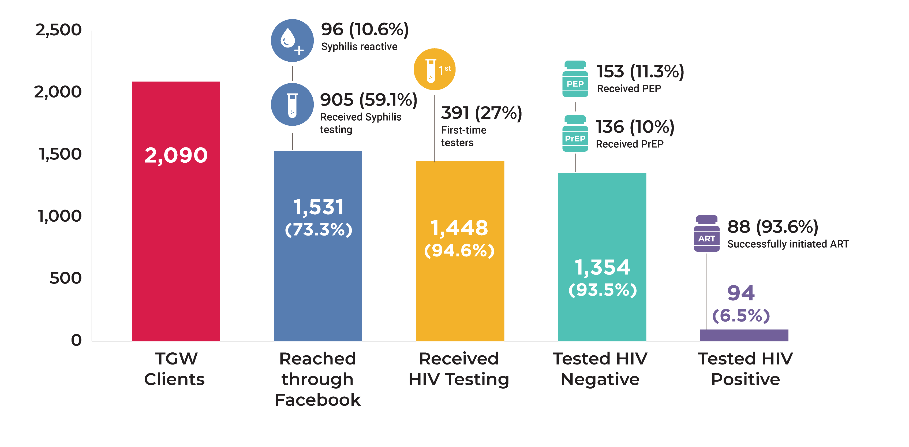
Figure 1: HIV cascade performance among transgender women clients recruited by trans social media influencers

Slide 7
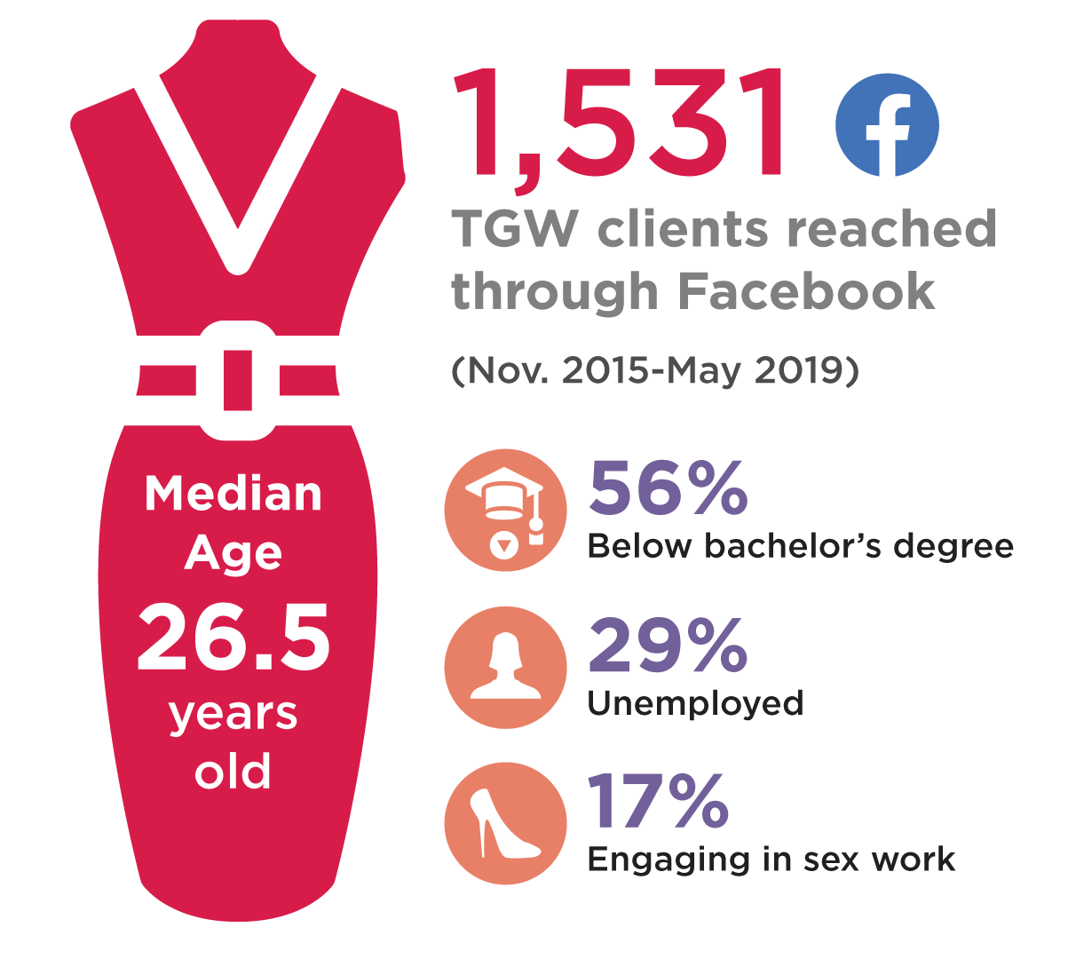
Figure 2:
Characteristics of transgender women clients who were reached through trans-social media interventions

Slide 8
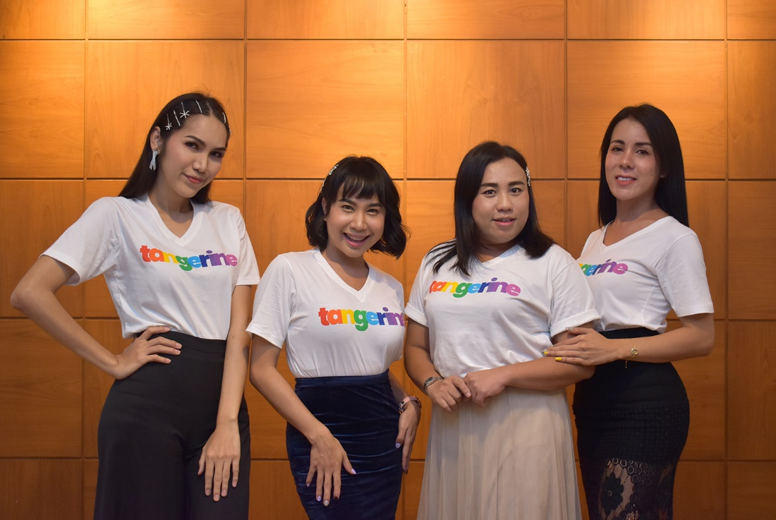
Conclusion
Trans-led social media interventions reached vulnerable TGW, identified those TGW at substantial risk of HIV acquisition, and facilitated linkages to HIV testing and treatment.
As GAHT services were the primary entry point into care for most TGW reached online, addressing specific trans health needs through virtual engagement should be brought to scale to increase the uptake of HIV prevention, care, and treatment services among transgender populations.

Slide 9





Acknowledgments
Kritima Samitpol
Jiratchaya Kongkapan
Artsanee Chancham
Tidarat Amatsombat
Jeeranuch Rueannak
Pintusorn Getwongsa
Peevara, Srimanus
Krittaporn Termvanich
Jakkrit Uttayananon
Pravit Mingkwanrungruang
Reshmie Ramautarsing
Matthew Avery
Stephen Mills
Ravipa Vannakit
Praphan Phanuphak
Nittaya Phanuphak

